Slide 1
Preserving Sensitive Data in Distributed Digital Storage Networks
SAA Research Forum 2020 - Platform Presentation
IMLS grant # LG-34-19-0055
Courtney C. Mumma (presenter), Deputy Director, Texas Digital Library
Notes:
Hello and welcome to Preserving Sensitive Data in Distributed Digital Storage Networks

Slide 2
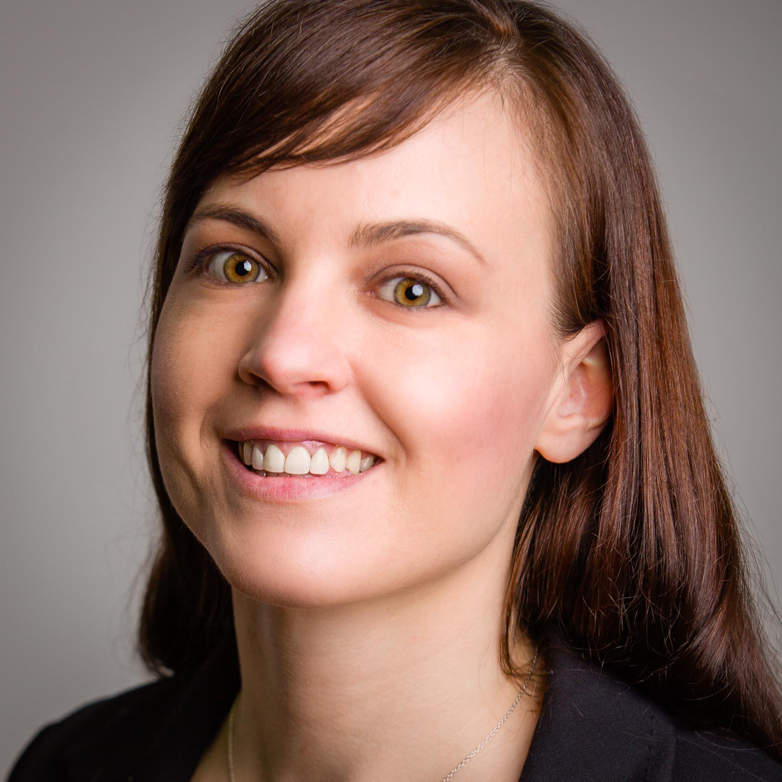
Kristi Park Texas Digital Library
Sibyl Schaefer UC San Diego
Courtney Mumma Texas Digital Library
Notes:
I am Courtney Mumma, the Deputy Director of the Texas Digital Library (TDL). My co-leads are Sibyl Schaefer, Digital Preservation Analyst at UC San Diego Library & Chronopolis Program Manager, and Kristi Park, Executive Director of TDL.
Funded through an IMLS Planning Grant, TDL and the UCSD Library have spent the past year exploring a nationwide model for the first Distributed Digital Preservation solution for sensitive and protected data.

Slide 3
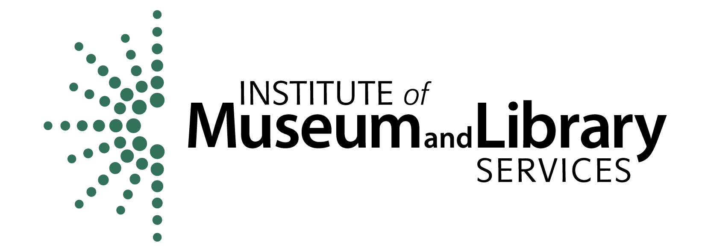
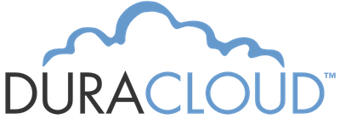
Notes:
Both TDL and UCSD Library have established business models and years of experience building and providing distributed digital preservation services, as well as a history of collaborating with one another on these services, which I’ll condense to “DDP” from here forward. TDL’s relationship with UCSD goes back to 2015.
UCSD, of course, manages the internationally-recognized DDP service, Chronopolis. The Chronopolis network spans three sites across the United States and is one of the earliest established DDP services in the world.
TDL, which is a consortium providing a number of services supporting digital libraries, has offered DDP storage services since 2015, and we became a replicating node for Chronopolis just a few years ago.
Beyond the main project partners and IMLS, we’ve been grateful for the support and participation of more than a dozen institutions shown on this slide.
These partners have, among other things, helped us collect use cases for private and sensitive data preservation and helped surface the technical, legal and service model needs and challenges.
[on slide: TDL, UCSD, Chronopolis, IMLS, TACC, SDSC, Academic Preservation Trust (APTrust), the Smithsonian Institute, Northeastern University, the University of North Texas Health Sciences Center, the University of Texas Southwestern Medical Center, the Dell Medical School at the University of Texas at Austin, DuraCloud/LYRASIS, and the Maryland Advanced Research Computing Center (MARCC) at Johns Hopkins University.

Slide 4
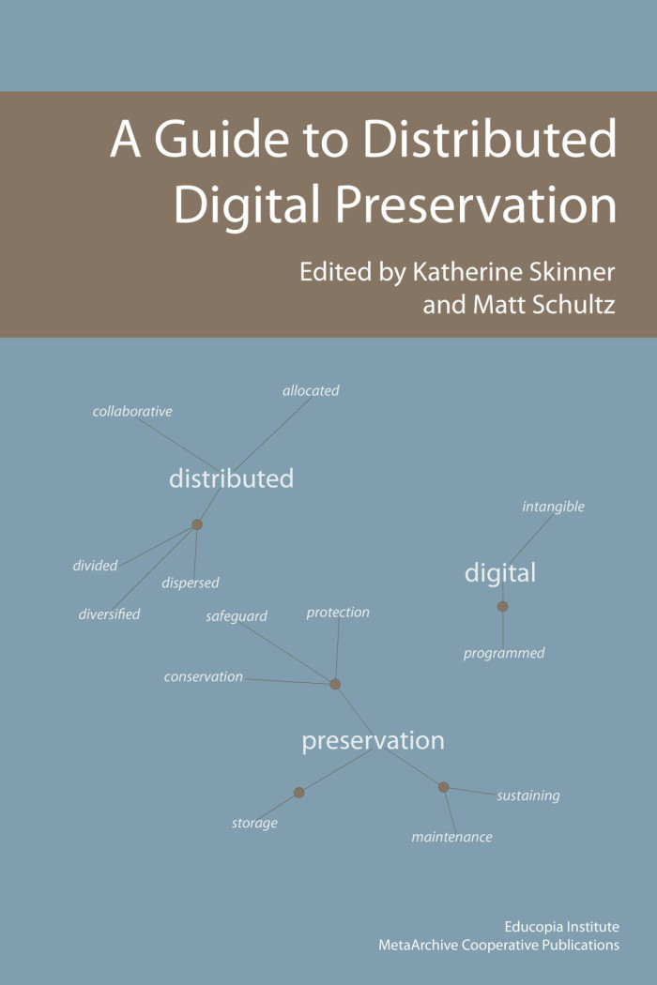
Distributed Digital Preservation (DDP)
Distributed digital preservation methodologies hold that any responsible preservation system must distribute copies of digital files to geographically dispersed locations. It also must preserve, not merely back-up, the files in these different locations.
MetaArchive Cooperative. A Guide to Distributed Digital Preservation, book, 2010; Atlanta, Georgia. (https://digital.library.unt.edu/ark:/67531/metadc12850/: accessed December 5, 2019).
Notes:
For the purposes of this planning grant, we are using the definition of the phrase ‘Distributed Digital Preservation’ shared by the MetaArchive Cooperative in its 2010 publication, A Guide to Distributed Digital Preservation. I won’t read the whole thing to you, but I’ll highlight that digital copies should be geographically dispersed using digital preservation good practice, and ideally in at least 3 locations. For more details about this definition, I encourage you to review the Guide.

Slide 5
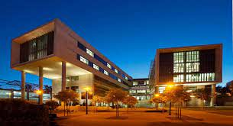
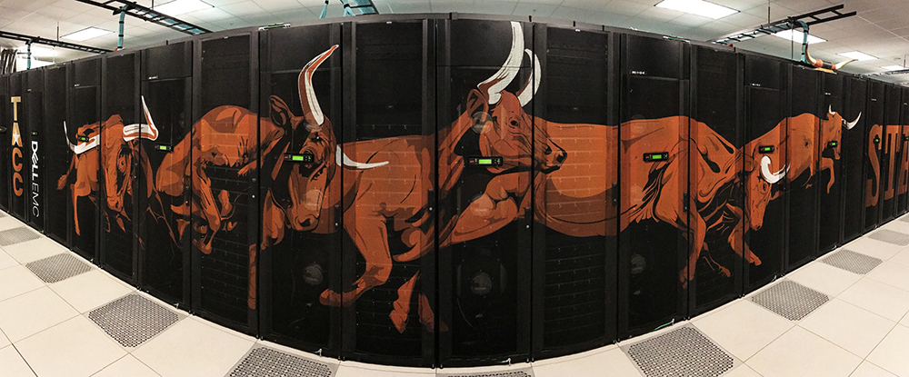
Notes:
Both TDL and UCSD Library maintain close working relationships with data centers affiliated with our home institutions that could provide key resources for a DDP service for sensitive data.
The Texas Advanced Computing Center (TACC) at UT Austin has partnered with TDL on several projects over the years and already provides storage resources for the TDL’s Chronopolis DDP storage node. For HIPAA (Health Insurance Portability and Accountability Act) and FERPA (Family Educational Rights and Privacy Act) secure and compliant storage, TACC has undergone a rigorous audit and costly compliance upgrades to accommodate local customers.
Similarly, the San Diego Supercomputer Center (SDSC) provides HIPAA compliant storage to its faculty and researchers at UCSD. Both computing centers have shared with us their expertise in providing sensitive data solutions, including details of their services and related costs.

Slide 6
Notes:
Grant partners convened in Austin in the end of 2019 to discuss the need for private and sensitive data DDP services, as well as the legal and technological challenges. We agreed that many institutions need such a solution since they are holding or planning to accept, for example, student records, email, health data, human rights archives including first person accounts of trauma, and commercially restricted data. Personally Identifiable Information (PII), Personal Health Information (PHI) and other sensitive data that has significant preservation value in libraries, archives, and academic health science centers is at an escalated risk of loss.

Slide 7
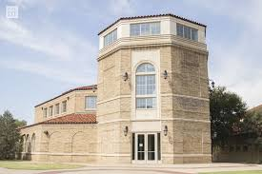
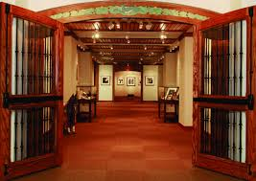
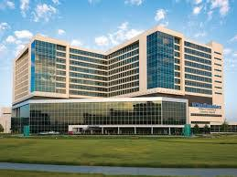
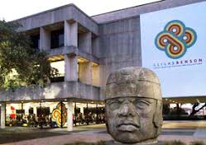
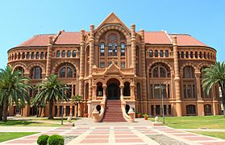
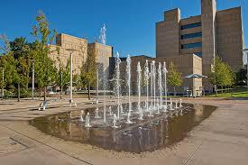
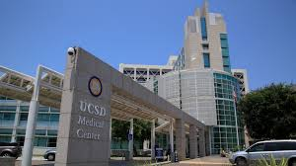
Notes:
Academic health science libraries, especially, face a growing backlog of digital PHI governed by HIPAA.
Additionally, university-held cultural heritage collections are likely to have materials governed by FERPA requirements as well as valuable cultural heritage materials that contain PII such as social security numbers and other data deemed sensitive or private based on local and jurisdictional rules.
Our case studies have also confirmed that it is common practice for archives to refuse any data that contains PHI or PII, regardless of its historical or evidential value because they don’t have the means to steward it or the resources to manage it. In some cases, the authority to manage materials properly is unclear and even if accessioned, there is a nowhere to put them.
And in other cases, we know that institutions haven’t done the level of assessment or appraisal necessary to quantify the problem sufficiently at all.

Slide 8
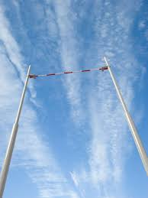
Notes:
The project team hypothesized that the bar set by HIPAA requirements is sufficiently high to protect many other kinds of nonregulated sensitive data. So based on that bar, what we are really looking at is what it takes to provide a HIPAA-compliant DDP network that will accommodate all the other kinds of PII I’ve mentioned. Note that we are deliberately excluding classified and top secret data.

Slide 9
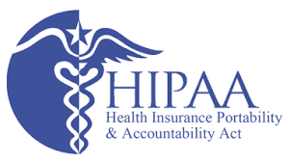
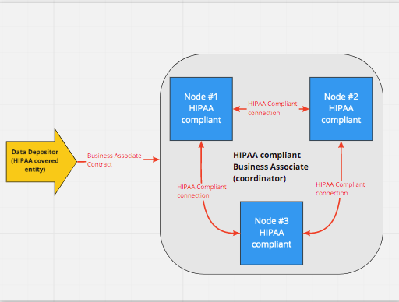
Notes:
This illustrates the very minimum, basic configuration and requirements of a HIPAA-compliant DDP network. It includes the essential roles of ‘business associate’ and ‘covered entity’. The covered entities are health plans, health care clearinghouses, and health care providers who electronically transmit any health information in connection with transactions for which the Dept of Health and Human Services has adopted standards. A “business associate” is a person or entity that performs certain functions or activities that involve the use or disclosure of protected health information on behalf of, or provides services to, a covered entity. Understanding these two roles is essential to understanding HIPAA-compliance, and attributing those roles to parts in a DDP network has proven to be core to planning for a service.

Slide 10
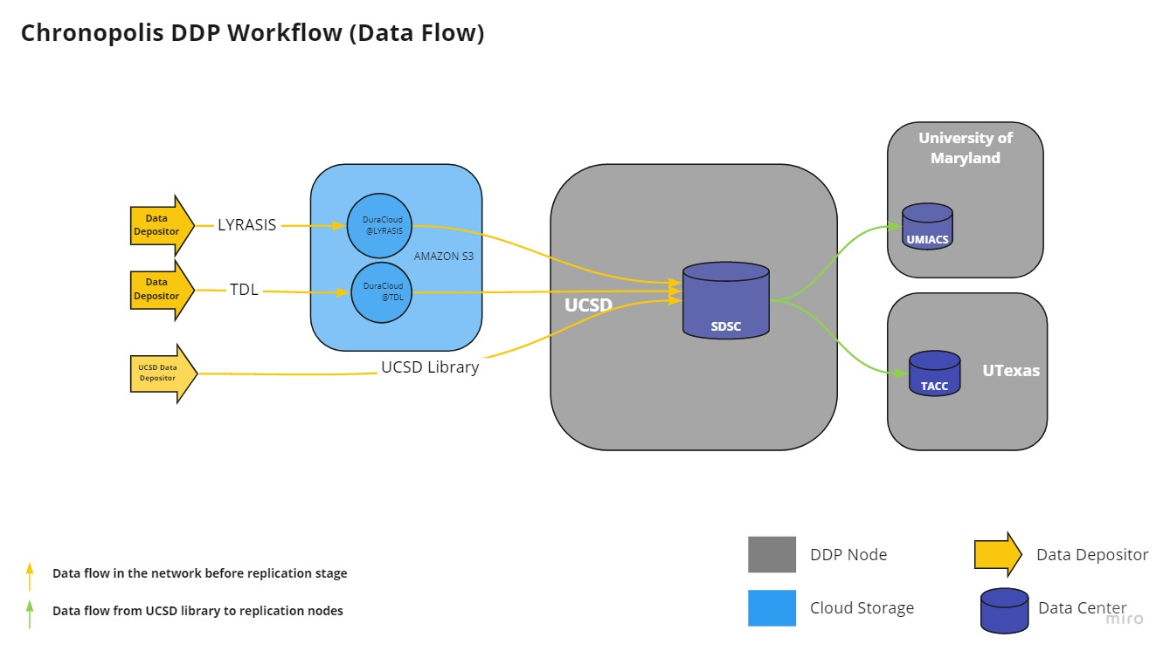
Notes:
We are working to overlay our existing DDP network infrastructure with the needs of the HIPAA one and identify the requirements to accommodate a subset of sensitive data without disrupting the regular service or undermining compliance to HIPAA as the gold standard.
Currently, SDSC and TACC are the only compliant nodes we’ve identified, so we’re already at a bit of a disadvantage in terms of being able to form a DDP network with a minimum of 3 distributed nodes.

Slide 11
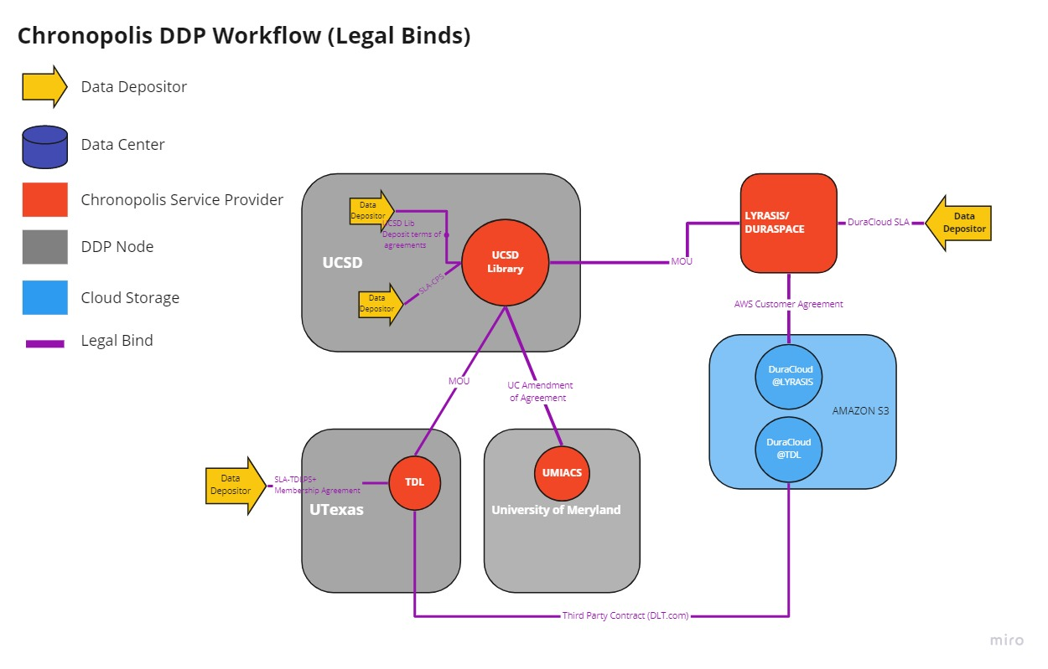
https://texasdigitallibrary.atlassian.net/wiki/x/O4BOOw
Notes:
This illustration shows the legal binds necessary to sustain the Chronopolis DDP network. As you can see, there are many connections which require legal agreements, and that creates a barrier to the formation of a DDP network for sensitive data that strictly follows HIPAA requirements.

Slide 12
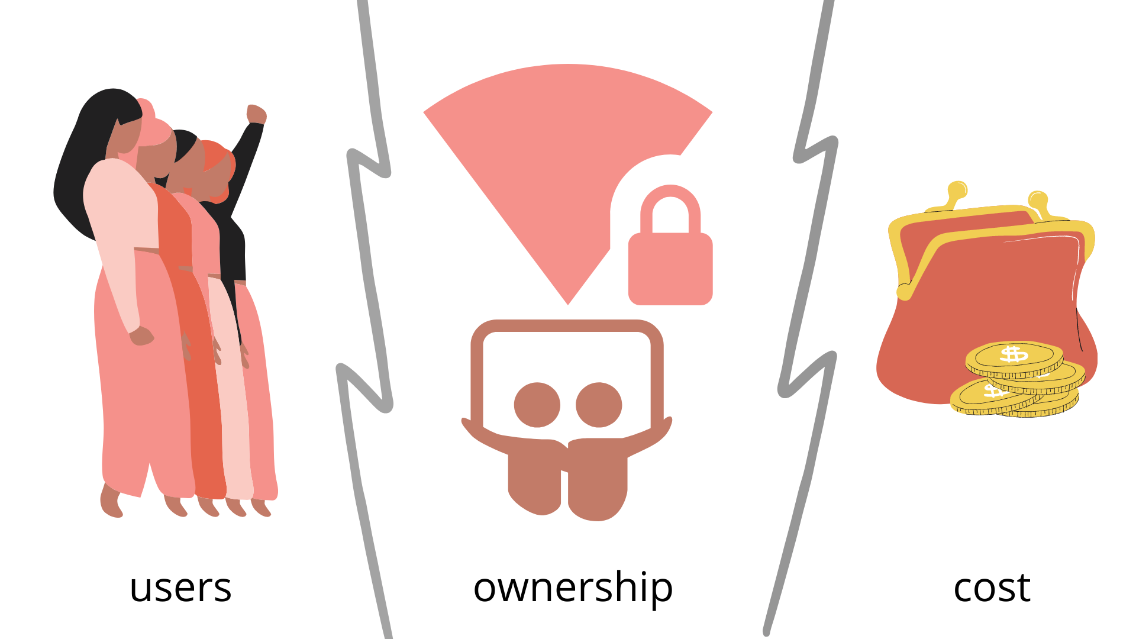
Notes:
But even beyond the complex legal underpinnings, a lack of user readiness, challenging questions about ownership & liability, and the exorbitant cost of HIPAA certification also undermine the feasibility of a service offering that accommodates private and sensitive data that is not PHI.

Slide 13
HIPAA Compliant
Single storage node or DDP
HIPAA-ish DDP
$$$$$ full audit and certification
Notes:
So,while the technology, infrastructure, and expertise needed to build a DDP service for sensitive data exist, the connections, agreements and processes to put it all together to form a viable service are lacking.
For those reasons, the grant partners are drafting recommendations for multiple service options. Our final report will include how UCSD and TDL could independently offer a fully HIPAA-compliant single storage node solution to their respective partners leveraging their existing partnerships with SDSC and TACC. We’ll also consider how we could connect these two nodes as a start to a full DDP network and as an entry point to initiate discussions with possible technical and community network partners.
Another option is to create a HIPAA-like DDP network, meeting all the requirements but without the costly audit and certification. Because we’ve found that so many of our partners aren’t actually accepting real HIPAA or FERPA data into their collections, we will redefine HIPAA’s ‘covered entity’ and ‘business associate’ for our own purposes.
Also, we know we need a better name than ‘HIPAA-ish’.

Slide 14
Virtual partner meeting
Report to include
Description of the project and methodology
Technical, legal and use case documentation
Recommendations for service models
Checklists for legal agreements to have in place
Maybe another grant?
Wooing of a Third Node!
Notes:
We are gathering our partners virtually this month to get feedback on our draft findings and recommendations. The final report we publish will include a detailed discussion of the project and our methodology, our technical, legal and use case documentation, recommendations for service models including governance and cost, and checklists for the enabling legal agreements to have in place for the various models.
As with any planning grant, we’re open to following up with another grant to move the work forward for any of our service model options.
And, we need a third node! Let us woo you. Or woo us.

Slide 15
woos & questions
c.mumma@austin.utexas.edu
sschaefer@ucsd.edu
kristi.park@austin.utexas.edu
Project documentation wiki - contains use cases, DDP documentation, legal binds, in person meeting notes and more…!
IMLS grant summary and full narrative
This project was made possible in part by the Institute of Museum and Library Services grant # LG-34-19-0055. https://www.imls.gov/grants/awarded/lg-34-19-0055-19
Notes:
For all your wooing needs, and to ask us anything you wish to know about the work, reach out to any of our project leads.
That concludes today’s presentation. Thank you to all of our partners who have participated so far.
You can find all of our project documentation on our wiki for the project, which contains use cases, DDP documentation and agreements, as well as all of our notes from our in person meeting late last year.

